Slide 1



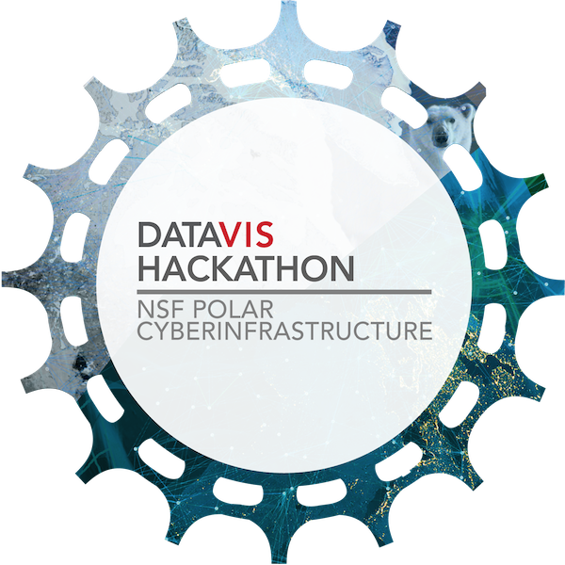
NSF DataViz Hackathon for Polar CyberInfrastructure
Chris Mattmann Chief Architect, Instrument and Science Data Systems Section, NASA JPL
Adjunct Associate Professor, USC
Board of Directors, Apache Software Foundation

Slide 2

Welcome!
To Parsons – The New School!
To NYC
To this hackathon!

Slide 3
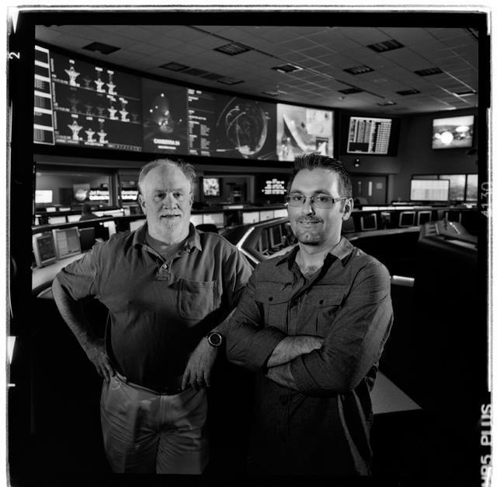
And you are?
Chief Architect at NASA JPL in Pasadena, CA USA
Software Architecture/Engineering Prof at Univ. of Southern California
One of original PMC members for Apache Nutch
predecessor to Hadoop
Apache Board of Directors involved in
OODT (VP, PMC), Tika (PMC), Nutch (PMC), Incubator (PMC), SIS (PMC), Gora (PMC), Airavata (PMC)

Slide 4
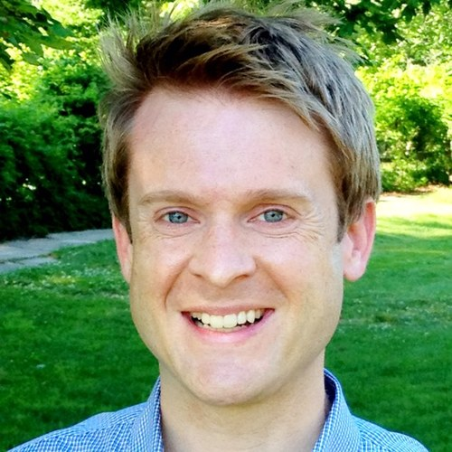
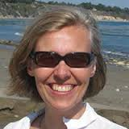
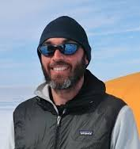
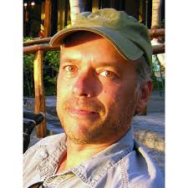
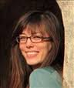
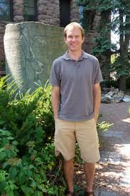
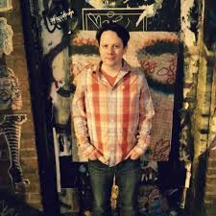
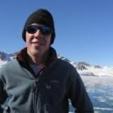
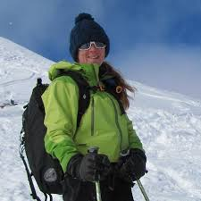
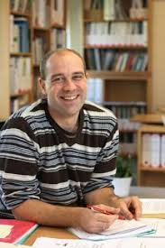
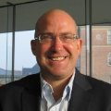
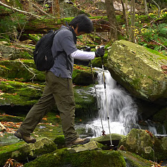
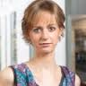
And you guys are?
Experts in the world in
Polar science
CyberInfrastructure
Data Visualization
Communication
Program Managers, coders, Presidential Innovation Fellows, University, NASA, NSIDC,

Slide 5
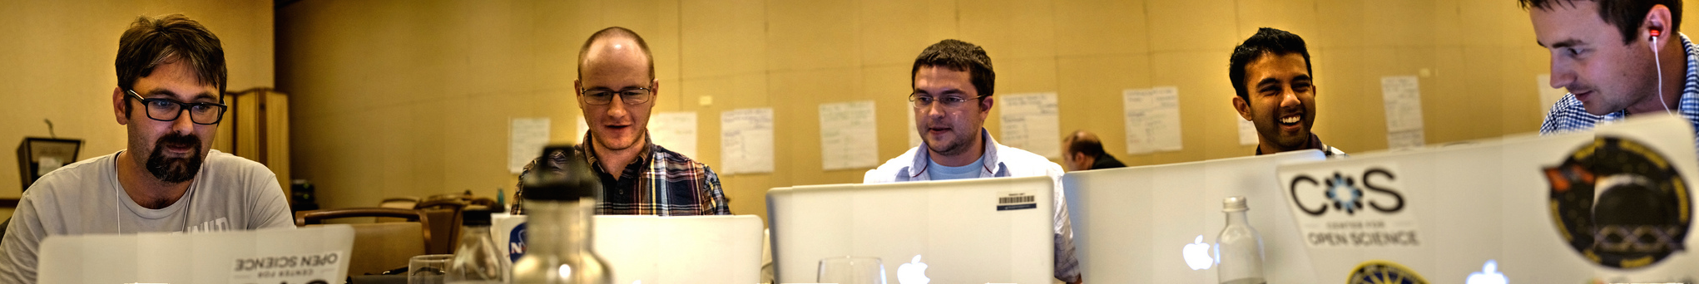
What’s a Hackathon
Core work products
Code (Pull Requests; Commits; etc.)
Demos/Apps
Demonstrations of technology and visualizations
New datasets

Slide 6
Format
Lightning Talks
Synthesis
Session Breakouts
4 hacking sessions
Report outs each day
Github constantly
Tweet
Report
Code
Amazon

Slide 7
Goals of this hackathon
Recommend CI technologies to the NSF Polar CyberInfrastructure program
Identify DataViz techniques and tools that are of value to the Polar sciences
Demonstrate the power of hackathons (Git, IRC, Twitter, etc.) to scientists, PMs, Viz and CI people
Produce code, checked into Github, and working prototypes

Slide 8
Session Instructions
17 proposed sessions
http://nsf-polar-cyberinfrastructure.github.io/datavis-hackathon/#sessions
How to maintain your session
https://github.com/NSF-Polar-Cyberinfrastructure/datavis-hackathon/wiki#how-to-maintain-your-session
Session synthesis
Pare down (if needed)
Likely 4 sessions per hack – organized by your participation

Slide 9
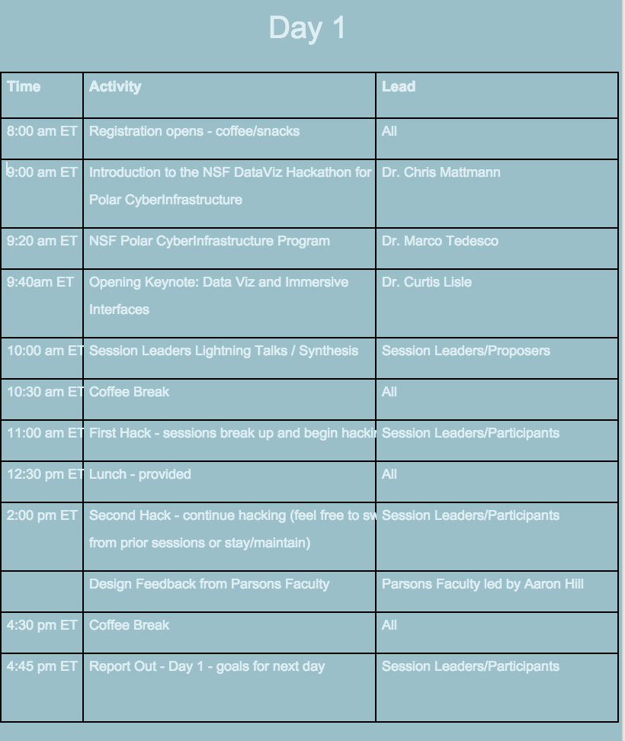
Agenda

Slide 10
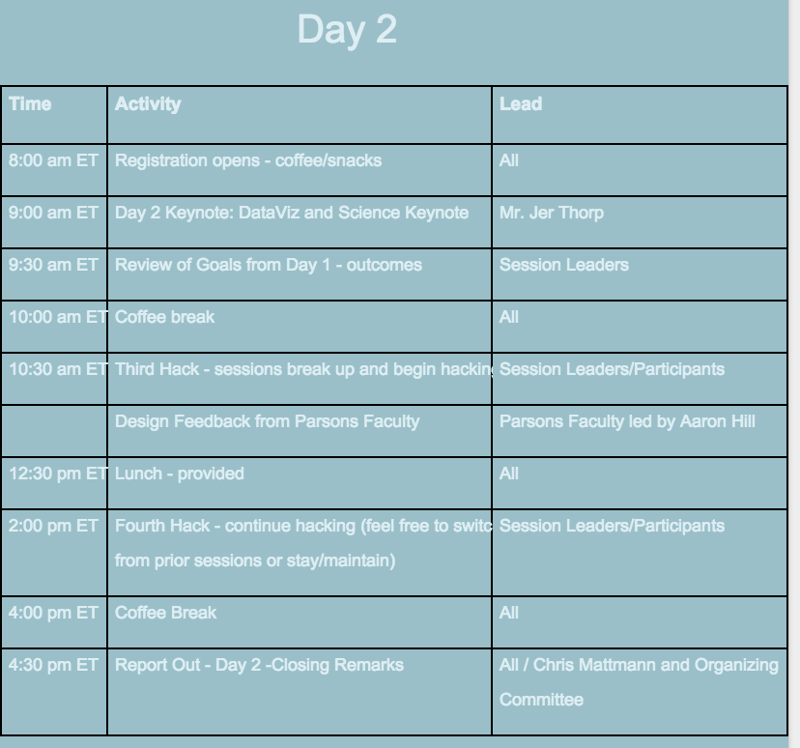
Agenda

Slide 11
Need help?
Katie Wanner – onsite coordinator (WiFi, logistics)
Paul Ramirez, Lewis John McGibbney, Maziyar Boustani – CyberInfrastructure, Amazon, Github, website
Aaron Hill – Parsons Faculty / Design Feedback
Marco Tedesco – NSF Program Manager and questions / conversations
Chris Mattmann – if all else fails

Slide 12

Thanks

